Slide 1
Price Action Trading
OM ADITYA
Pipraisers Capital Market Analyst Intern

Slide 2
Supply and Demand
Supply
Sell orders
Buy orders < Sell orders
Sellers are dominant
Decline in prices
Demand
Buy orders
Buy orders > Sell orders
Buyers are dominant
Increase in prices

Slide 3
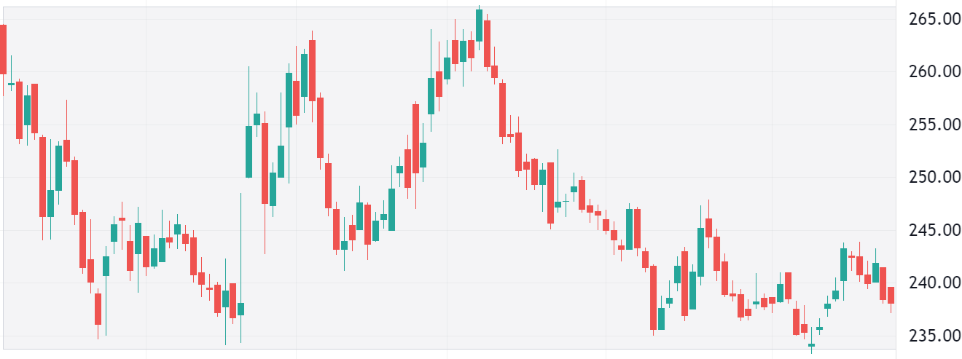

Slide 4


Sellers

Slide 5
Supply Zone

Slide 6
Buyers

Slide 7
Demand Zone

Slide 8
Supply Zone
Demand Zone

Slide 9
Trade-1: Sell
Trade-2: Sell
Trade-2: Buy
Trade-1: Buy

Slide 10
SUPPORT AND RESISTANCE

Slide 11
SUPPORT AND RESISTANCE
Resistance

Slide 12
SUPPORT AND RESISTANCE
Support

Slide 13
Supply Zone
Demand Zone

Slide 14
Pattern formation

Slide 15
Reversal Patterns
Continuation Patterns

Slide 16
REVERSAL PATTERNS
Bearish Reversal
Bullish Reversal

Slide 17
Bearish Reversal Pattern
Uptrend
Trend
Reversal
Signals a supply zone and indicates a possible reversal of the uptrend

Slide 18
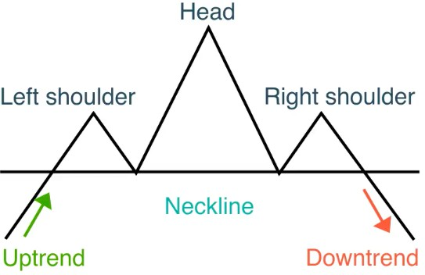
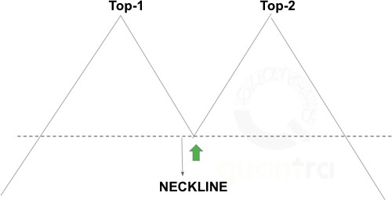
Top-1
Top-2
Top-3
NECKLINE
Head and Shoulders
Double Top
Triple Top

Slide 19
Downtrend
Trend Reversal
Bullish Reversal Pattern
Signals a demand zone and indicates a possible reversal of the downtrend

Slide 20
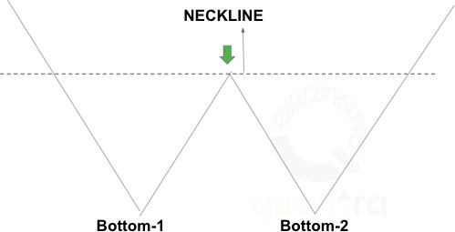
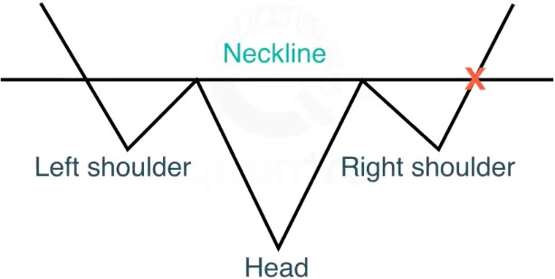
NECKLINE
Bottom-1 Bottom-2
Bottom-3
Inverse Head and Shoulders
Double Bottom
Triple Bottom

Slide 21
Uptrend
Continuation Pattern
In an uptrend, a continuation pattern signals the
Uptrend
formation of a demand zone and indicates the
continuation of the uptrend

Slide 22
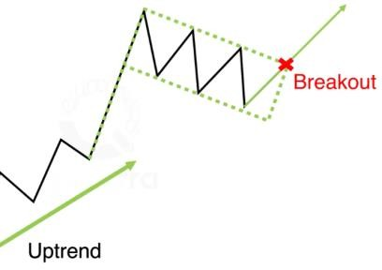
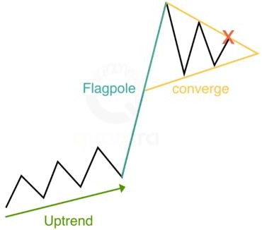
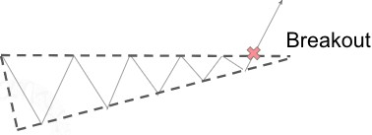
Bull Flag
Pennant
Ascending Triangle

Slide 23
Downtrend
Continuation Pattern
In an downtrend, a continuation pattern
signals the formation of a supply zone and
indicates the continuation of the
downtrend
Downtrend

Slide 24
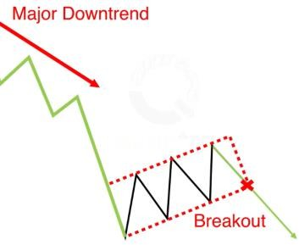
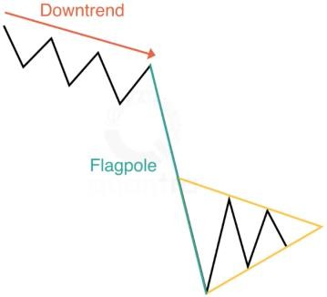
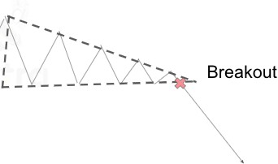
Bear Flag
Pennant
Descending Triangle

Slide 25
Market structure and patterns
HH
HH
HH
HH

Slide 26

HH
LH
HH
HH
HH

Slide 27
HH
LH
HH
HH
HH

Slide 28
HEAD
HH
LH
HH
LEFT SHOULDER
RIGHT SHOULDER
HH
HH
UPTREND
NECKLINE
DOWNTREND
Indicates weakness in an uptrend
Possible reversal of an uptrend

Slide 29
HEAD
Lower High Indicating Weakness in an uptrend
Breakout of Support Indicates Strength of Sellers
LEFT SHOULDER
RIGHT SHOULDER
UPTREND
NECKLINE
DOWNTREND

Slide 30
Trading head and shoulders pattern
Stop-Loss Above the Right Shoulder
H
SL
Enter short at breakout of the neckline
NECKLINE
Entry
UPTREND
H
TAKE PROFIT

Slide 31
THANK YOU

